Slide 1
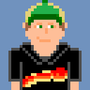
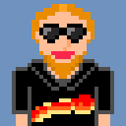
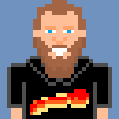
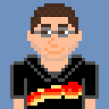
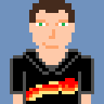
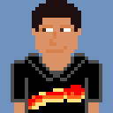
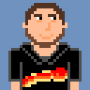
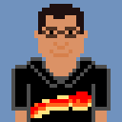
Berserker Project Update
Presented By: 8-Bit Bacon
Daniel Lima
Charles “CJ” Meade
Justin Maza
Roberto Rubiano
Matthew Birky
Sean Welch
Santiago Hoyos
Oscar Valera
Notes:
Oscar
Present the team and the names of everybody who will be talking.

Slide 2
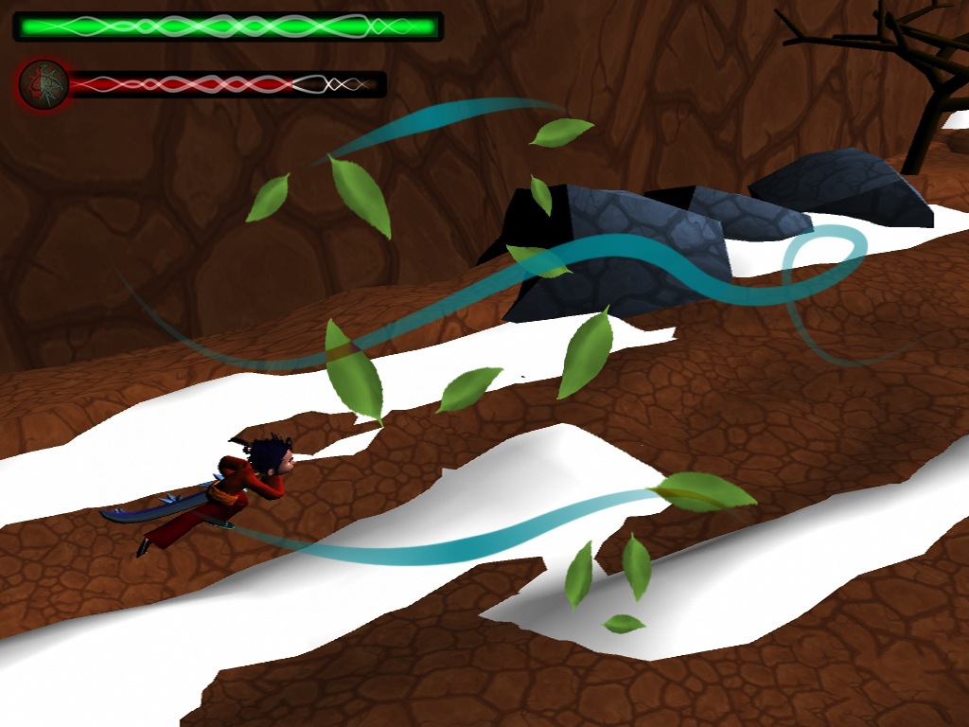
Game Information
Berserker
¾ View
Hack and Slash
Goal: kill the wizard, save your lover
Notes:
Oscar
Talk about the game name, Berserker, say that it is a ¾ view isometric hack and slash game and explain how the main character’s lover was kidnapped by a wizard and your goal is to find him, kill him and recover your love.
Pass it to Roberto for the Walkthrough.

Slide 3
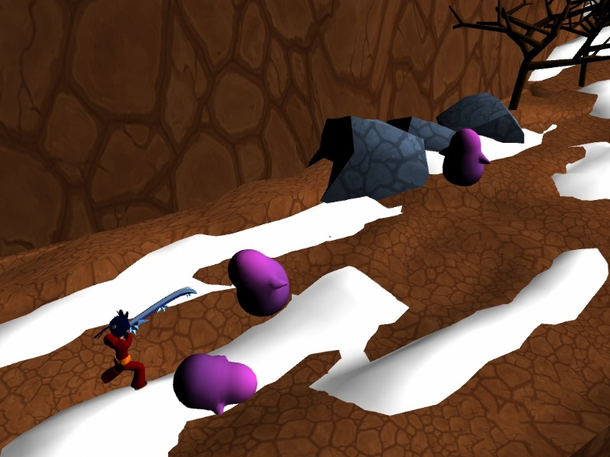
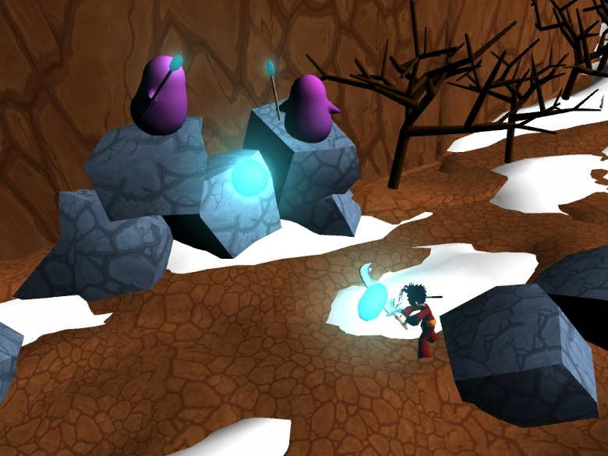
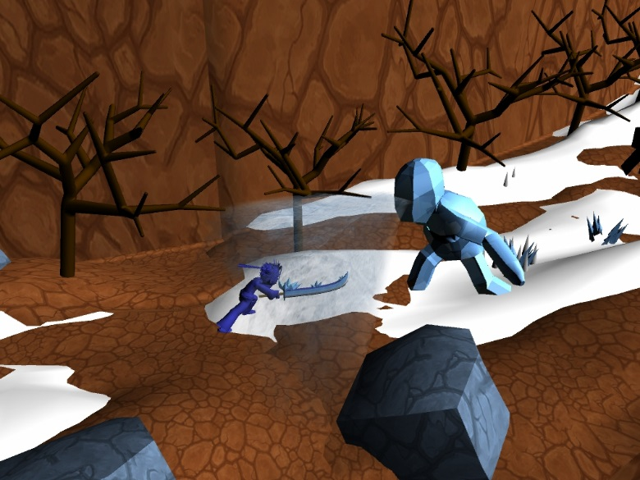
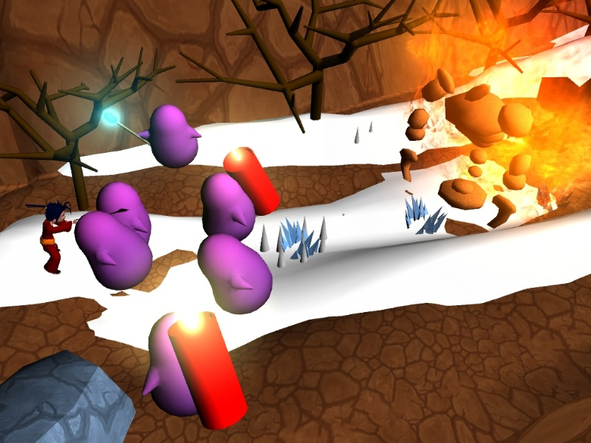
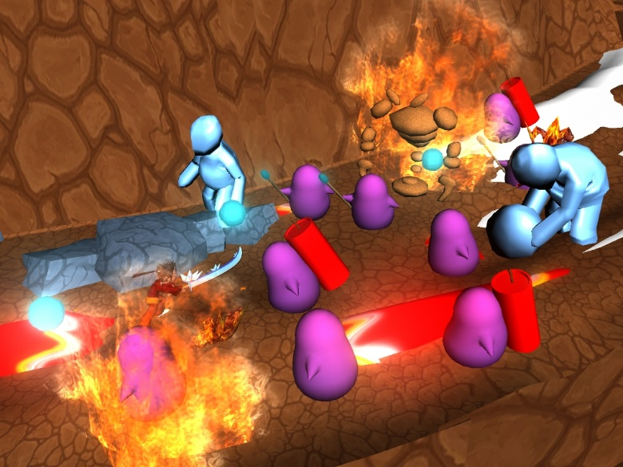
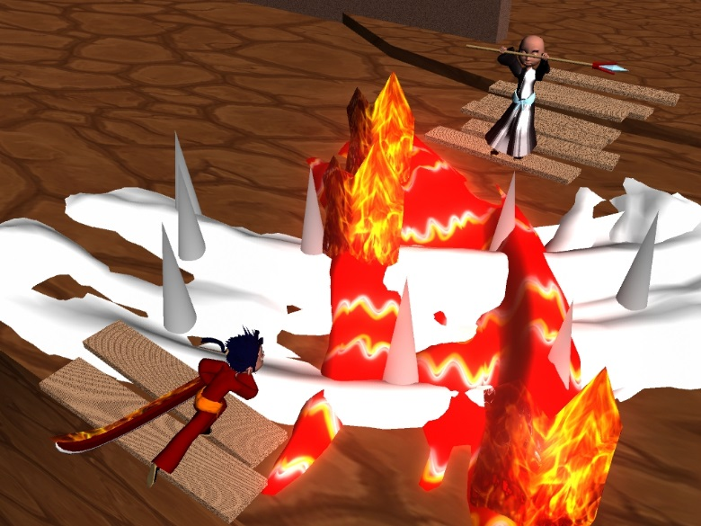
Walkthrough
Notes:
Roberto
Explain how the game starts, how we teach the player to fight, deflect and use Fire and Ice. (First 3 images)
Explain how the game gets a little harder when you start running into more complex enemy waves culminating with the Wizard battle in the end.

Slide 4
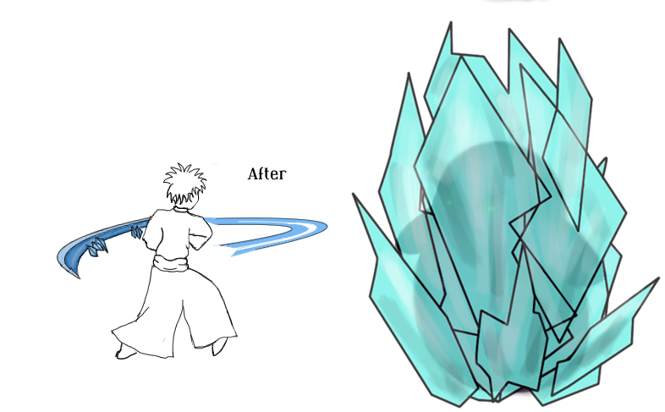
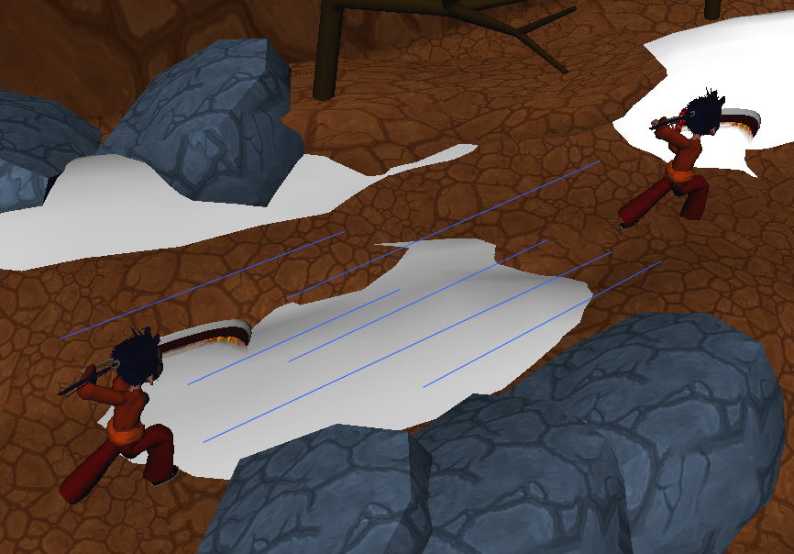
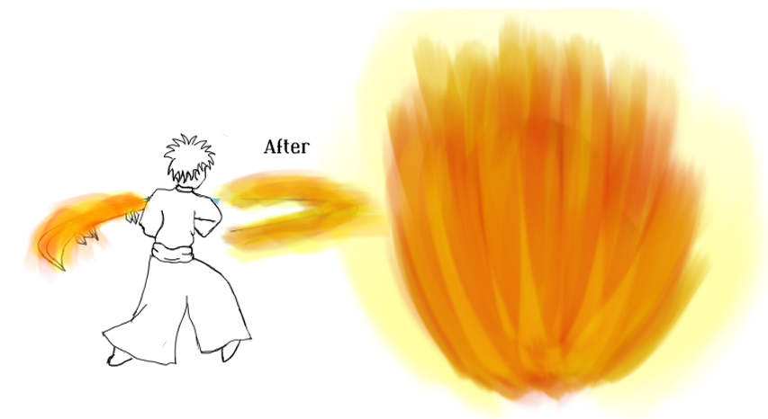
Core Gameplay
Fire and Ice
Dash
Rage
Notes:
Roberto
Explain our 3 main features:
Fire and Ice – How the player has both attacks and how they affect the enemies, besides talking a little bit about the traps of the same kind
Dash – How the player can use dash to avoid traps, get close to enemies and avoid enemies attacks - also dashing into the explosive enemy to send him into other enemies
Rage – How you build up rage by attacking enemies and you can use it to double your attack power
Pass it over to Santiago for Inspiration and Art

Slide 5
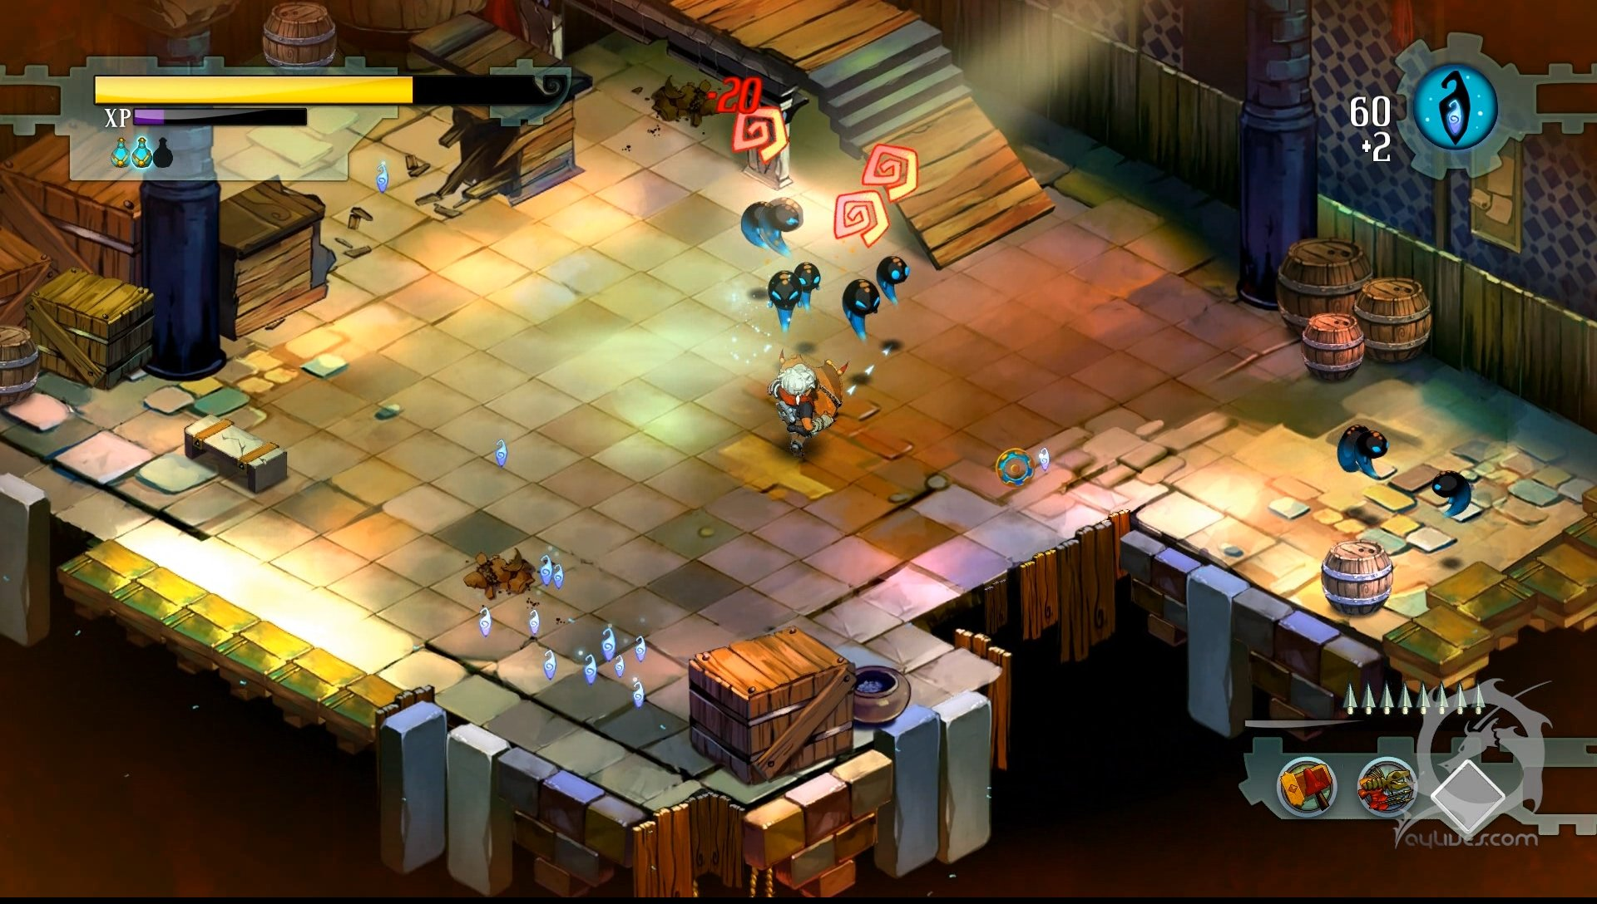
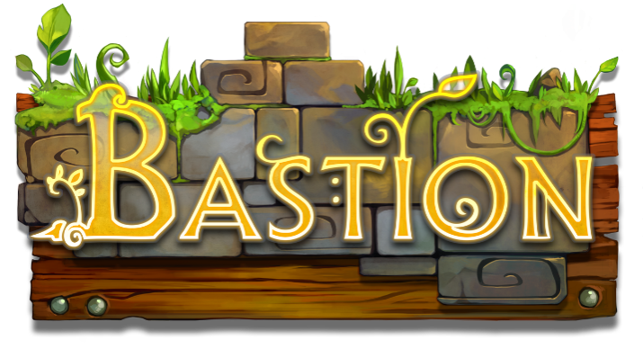
Inspiration
Notes:
Santiago
Explain what our game has in common with Bastion – Both ¾ view isometric hack and slash games in which the player is basically running through areas and killing waves of enemies.

Slide 6
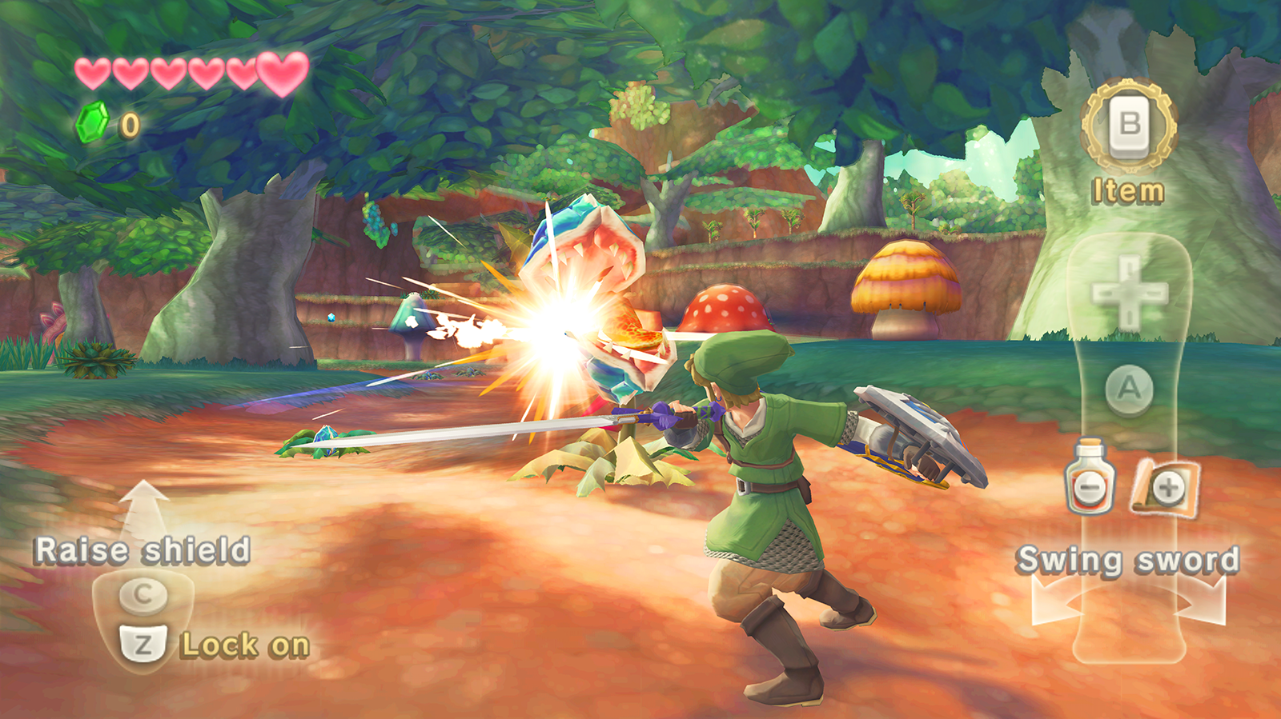
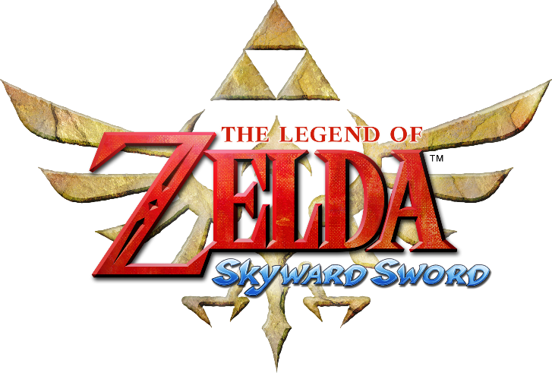
Art Style
Notes:
Santiago
Explain the art style for our game relating it to Zelda Skyward Sword. You know more about art than I do so you should be able to talk about this for some time =)
Pass it over to Daniel for current status of the game

Slide 7
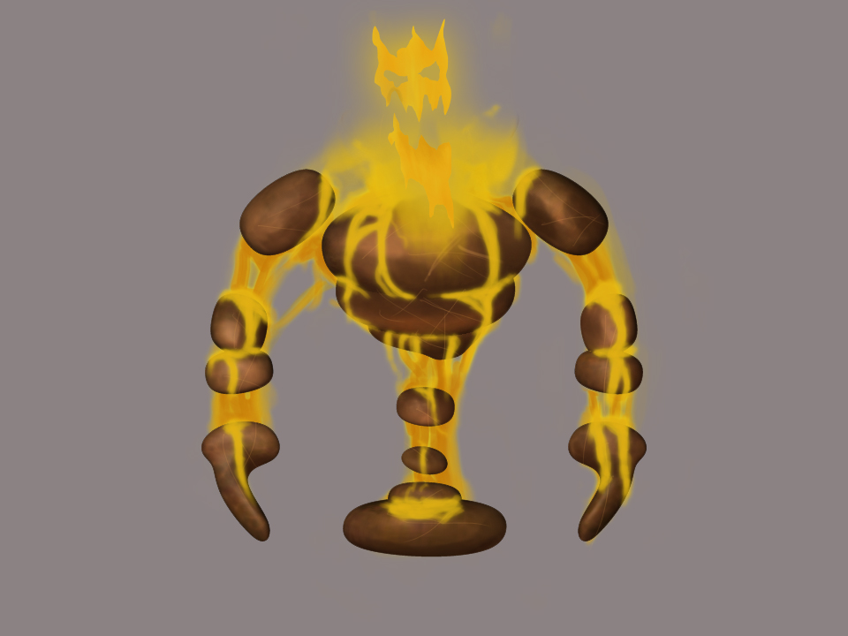
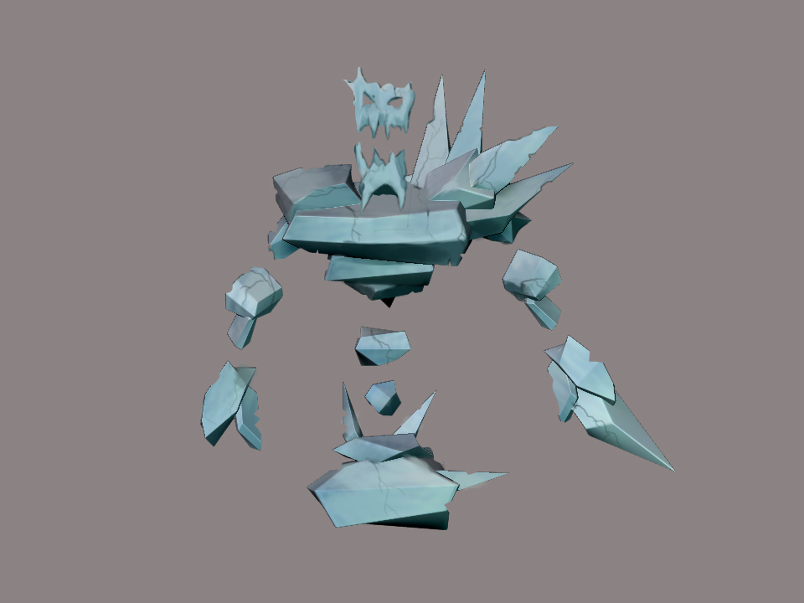
Current Status
Dropped: Grab / Throw
Dropped: Basic Attack
Added: Fire and Ice
Changed: Rage
Notes:
Daniel
Talk about the features that we had to drop, add or change and why we did what we did.

Slide 8
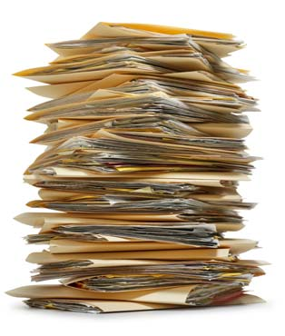
Documentation
Goals after Pitch
Fire and Ice interaction
Make the game fun
Make more art
Goals were met!
Problems
What to drop, what to keep
Only two artists
Notes:
Daniel
Talk about the feedback we got after our initial pitch and the goals we set for our documentation
Pass it over to CJ to talk about our Team

Slide 9
Team Roles
Pseudo Internal Producer: Matthew Birky
Technology Lead: Charles “CJ” Meade
Gameplay Lead: Sean Welch
Quality Assurance Lead: Daniel Lima
Design Lead: Justin Maza
Asset Lead: Roberto Rubiano
Concept Artists: Oscar Araque and Santiago Hoyos
Notes:
CJ
There’s not a lot to talk about in here. Just say each person’s role in the team and maybe explain what each position is supposed to do.

Slide 10

Team Communication
Very communicative team
Meeting on school Monday through Saturday
Skype group conversation
Strengthened
Developer-Artist communication
Still to be improved
Everybody being on the same page
Notes:
CJ
You can honestly make up whatever you want in here, everything is on the slides.
Pass it over to Justin for decision making and things we learned.

Slide 11
Decision-making Process
Group Discussion
Voting sometimes
Difficult decision – How the rage mechanic would work
Notes:
Justin
Talk about how we would usually get to conclusions by just discussing as a team, in which each person would give their opinion on a matter and we would try to find a middle ground that made everybody happy. In case that didn’t happen because people’s opinions were so divergent, we would vote to decide.
One of the most difficult decisions we had to take as a group is how the rage mechanic would work. In the beginning the player would charge rage with basic attacks and unleash it for Fire and Ice attacks. Later we made it so that you would only use part of the rage instead of all of it. And then we got rid of the basic attack, made the Fire and Ice attacks available all the time and the Rage became just a temporary increase on your attack power and effect after you’ve used it.

Slide 12
Things we learned
Overcome
Different gaming experience between the members
Proudest team accomplishment
Balance between Fire and Ice
Anticipated struggles
Actually coding the game
Notes:
Justin
One of the things we had to overcome as a team is that we had slightly different gaming background, so we decided to make a game inspired by Bastion but some of our team members had never played anything like that.
Our proudest team accomplishment was being able to balance the Fire and Ice attacks with the enemies and environment, we think we did a good job on that.
What we are anticipating to struggle, well, actually code this whole game!
Pass it over to Birky for goals reached.

Slide 13
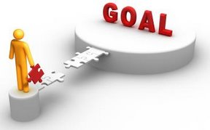
Team goals reached
Design a game that the entire team is happy with
Notes:
Birky
Feel free to add anything to this slide cause I think it’s a little empty but basically talk about what we wanted, as a team, for the outcome of this month to be: A game design that we would all be happy with. I think we accomplished this goal. You could maybe say that each one of us had a personal thing that we managed to include in the game and because of that we’re all glad with the final project, or something along those lines.

Slide 14
Current team goals
Project Goal – Make Rod pleased ☺ (and a good game of course)
Team Goal – Celebrate together the end of Month 1
Public Speaking – Prepare ourselves to answer questions better
Notes:
Birky
Well I think this is straight-forward. If you feel like adding anything it’s cool as well.

Slide 15

Questions?
Notes:
Birky

